Slide 1
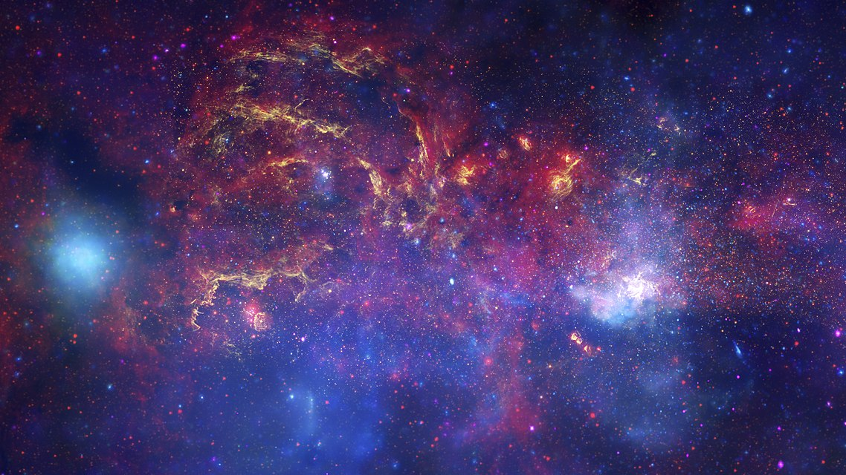
AI from Space using Azure
Christos Charmatzis
@christoscharmatzis
https://tageoforce.com
Center of the Milky Way Galaxy
Source: Wikipedia
Notes:
Welcome to the 1st Global AI Bootcamp 2019 in Athens.
Title of the presentation is “AI from Space using Azure”.
I am Christos Charmatzis and this is the center of our galaxy as the Hubble Space Telescope, the Spitzer Space Telescope, and the Chandra X-ray Observatory have producted.
[click]

Slide 2
Agenda
Few things about me
Introduction to AI
Earth Observation Data and how use them
How we processing satellite images
Going to Azure for full power
How we deliver our study
Conclusions

Slide 3

Few things about me
Project manager @TA-Geoforce
GIS Specialist 10+ years
AI professional
Open Source enthusiasm
Piano player
Chopin – Heroic Polonaise
Source: youtube.com/Rouseau

Slide 4
What they show us
A.I. is here
(I guess…)
Statistics
Data
Technology
Notes:
We all have here this so many times from so many people,
( I tell that because it’s nice to remember the high skills that we Data Scientists have!!!!)
that if we have 3 sets (circles) which are Data, Statistics and Technology
[click]
AI is the common space between them.
[click]
I guess and I say I guess because now days AI is more a brand name, that a scientific definition.
[click]

Slide 5
What’s AI for me
AI Knowledge
Data
All of us
Notes:
We all have here this so many times from so many people,
( I tell that because it’s nice to remember the high skills that we Data Scientists have!!!!)
that if we have 3 sets (circles) which are Data, Statistics and Technology
[click]
AI is the common space between them.
[click]
I guess and I say I guess because now days AI is more a brand name, that a scientific definition.
[click]

Slide 6
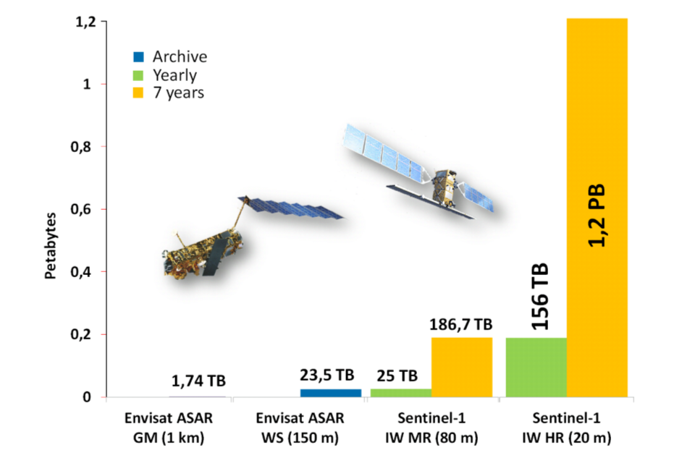
Data from Space
Only ESA satellites produces around 150 terabytes per day!!
(source:https://www.esa.int/Applications/Observing_the_Earth/Working_towards_AI_and_Earth_observation )
Growth of data volume from ENVISAT ASAR to Sentinel-1.
Source: Big Data Infrastructures for Processing Sentinel Data - Wolfgang Wagner, Vienna - 2015
Notes:
Data from Space

Slide 7
Did you know that Azure has an Open Data Catalogue?
MODIS
NAIP
NOAA Global Forecast System (GFS)
Harmonized Landsat Sentinel-2
NOAA Integrated Surface Data (ISD)
Daymet
And the best part is that are FREE OF CHARGE!
https://azure.microsoft.com/en-us/services/open-datasets/catalog
Notes:
Azure has an open data catalogue with big datasets, you can find this catalogue here
https://azure.microsoft.com/en-us/services/open-datasets/catalog
Did you know that 6 from 27 (22.2%) are earth observation and every day refresh data?

Slide 8
Let’s get started
Talk with the client about the goal of the AI project.
Split the question that needs to be answered in small questions.
Search for datasets
Create the project structure.

Slide 9
Let’s get started
Talk with the client about the goal of the AI project.
Split the question that needs to be answered in small questions.
Search for datasets
Create the project structure.

Slide 10
Space Data and Big Data
The catch….
is that Space data are never
Small

Slide 11
Is there any Hope?
Since everything is relative:
- If you are studying (labeling) small features (e.g. roofs, cars, parking places) you are OK!!! There is nothing to worry about Big Data
If you are studying (labeling) large features (e.g. lakes, oil spills, forests)
You are in Big (Trouble) Data!!!!

Slide 12
Agenda
Few things about me
Introduction to AI
Satellite data and how use them
How we processing satellite images
Going to Azure for full power
How we deliver our study
Conclusions

Slide 13
Conclusions
Space data have really been exploded and it’s gonna get a lot worse.
There are unlimited applications that can be developed using them.
Earth observation knowledge using AI is really the next big thing.

Slide 14
Thank U & Questions

